Slide 1
SART Registry Update

Slide 2
Changes
Data collection
Clinic summary report

Slide 3
Changes in Data Collection and Reporting
Purpose / goal
Keep pace with changes in clinical practice
Comply with the ART data collection and reporting requirements of the Fertility Clinic Success Rate and Certification Act (FCSRCA) aka Wyden Law
Input from membership has been essential

Slide 4
FCSRCA - Background
Consumer protection legislation - 1992
Defined “assisted reproductive technology”
All treatments or procedures which include the handling of human oocytes or embryos
Defined data reporting mechanism
Reporting to Secretary of Department of Health and Human Services through the Centers for Disease Control and Prevention

Slide 5
FCSRCA - Background
Defined the pregnancy success rate metric
“by dividing the number of pregnancies which result in live births by the number of ovarian stimulation procedures attempted by such program”
Also defined a second success rate metric
“ the live birth per successful oocyte retrieval”
Lastly indicates that additional success rate definitions be developed in consultation with appropriate consumer and professional organizations (e.g. ASRM / SART)

Slide 6
FCSRCA - Background
Rules / regulations (administrative law) describing the details of who shall report, the reporting system and the process for reporting by each clinic are published by CDC in the Federal Register initially in draft versions. Final rules are published after solicited comments to the draft version are reviewed.

Slide 7
Federal Register Publications
Draft Aug 26, 1997
SART in conjunction with CDC made a number of revisions to the reporting process shortly after publication
Draft Sept 3, 1999
Final Notice Sept 1, 2001
Notice Feb 5, 2004 and Feb 1, 2005

Slide 8
Federal Register – September 2001
Who reports
ART program is defined as a legal entity practicing under state law, recognizable to the consumer
Can be an individual physician or a group of physicians who practice together and share resources and liability
Reporting deadline
January 15 of the year 2 years subsequent to the reporting year
SART in conjunction with CDC may change the deadline if needed

Slide 9
Federal Register – September 2001
Prospective reporting anticipated
Clinics will be provided at least 90 days notice of this requirement
External validation of reported data
CDC contracted with SART to perform
Note – SART participation in validation efforts was removed from the contract for 2013

Slide 10
Federal Register – September 2001
Describes data to be reported including the data items and definitions
Embryo banking cycle
Cycle initiated with the intent of cryopreserving all fertilized embryos for later use
Does not apply to cycles initiated with the intent to transfer embryos but for which all embryos were cryopreserved regardless of the reason
Egg freezing not included
Minimal stimulation not included
In vitro maturation not included

Slide 11
Federal Register – September 2001
Describes the content of published report
National component
Clinic specific component
Pregnancy success rate defined
Pregnancy per all ovarian stimulation or monitoring procedures
Live birth per stimulation or monitoring
Live birth per oocyte retrieval procedures
Live birth per embryo transfer procedures

Slide 12
Federal Register – February 2005
Describes change in the data collection contractor
Web-based data reporting system developed by Westat called the National ART Surveillance System (NASS)
Deadline for reporting moved to December 15 of the year following the reporting year
Clarifies that all collection of information must be approved by the Office of Management and Budget under the terms of the Paperwork Reduction Act of 1995

Slide 13
Data Collection Updates
Synchronization of definitions with CDC (NASS variables)
Minor modifications
e.g. definition of diminished ovarian reserve
Addition of new data fields
Donor and autologous egg freezing
Egg / embryo banking details expanded
IVM
Minimal stimulation (SART not CDC)
Deletion of some data fields felt to be of lesser value
Notes:
We have attempted to balance the burden of reporting additional fields with the advantage of collecting additional data. Some data fields have been deleted

Slide 14
Changes in CSR
Necessary due to recent changes in clinical practice
Delayed transfer is becoming more common and must be distinguished from true “fertility preservation”
Many clinics offer both “lower-cost” and “premium” ART options and would like to distinguish these different outcomes to the consumers of fertility services
Egg freezing is no longer “experimental” and is being offered commercially by clinics

Slide 15
Changes in CSR
Prospective reporting percentage will be clearly shown
Natural cycles, minimal stimulation and IVM will be included in the default report, but filters will allow views of these cycles independently as well as a view of the report with these cycles removed
Outcomes for autologous frozen embryo transfer cycles will be reported per thaw rather than per transfer
Outcomes for egg donation will be by cycle start rather than per transfer
Labels for autologous non-donor cycles will change from “fresh” and “frozen” to “primary” and “subsequent” to allow linkage of delayed embryo transfers to cycle starts

Slide 16
Egg / Embryo “Freeze all” Cycles
Fertility preservation (banking)
Short-term autologous delayed transfer (cryo all with intent to use within 12 months of cycle start)
PGD / PGS
Endometrial receptivity concerns
Risk of OHSS
Inability to obtain sperm
Planned multiple cycles (egg / embryo accumulation)
Other
Donor egg banking

Slide 17
Delayed Embryo Transfer / Short-term Egg / Embryo Banking (Autologous cycles)
Recognized need to distinguish between this and true “fertility preservation”
Outcomes from “delayed transfer / short term banking” are available in a reasonable time-frame and should be included in the CSR
Fertility preservation outcomes cannot reasonably be included in the CSR

Slide 18
Delayed Transfer – Key Elements
All cycle starts are included in the denominator of the outcome report
Delayed transfer can be intended at cycle start or decided at any point prior to transfer
The outcome of the first embryo transfer following stimulation will be included in the numerator of the outcome statistic
This transfer can occur within the year of the cycle start or the following year if within 12 months of cycle start
The outcome will be reported in the year of cycle start if possible
If the transfer is significantly delayed, the outcome of the cycle will in some cases be reported the year following the cycle start

Slide 19
Delayed Transfer – Key Elements
Lack of embryos (or lack of genetically normal embryos following PGS/PGD) available for transfer will result in a negative outcome for the cycle
This should be reported during the year that lack of available embryos is determined
Lack of embryo transfer in the year of the cycle start or within 12 months of cycle start will result in a negative outcome for the cycle
This negative outcome will be reported in the year following the cycle start

Slide 20
Current Report
 | Fresh ET | Fresh and Frozen ET | Mixed Fresh/Frozen ET
RY 1
RY 2
Retrieval
Retrieval
Retrieval
Fresh ET
Fresh ET
Cryopreservation
Fresh ET
Cryopreservation
Outcome
Outcome
Frozen ET
Primary efficacy
Primary efficacy
Retrieval
Outcome
Primary efficacy
Fresh ET
Frozen ET
Outcome
Outcome
Secondary efficacy
Primary efficacy

Slide 21
Intentional Delayed Transfer – Current Report
 | Short-term E. Banking with deferred transfer | Short-term E. Banking (no embryos available for transfer)
RY 1
RY 2
Retrieval
Retrieval
E. Banking
E. Banking
Frozen ET
No transfer
Outcome
Unreported
Secondary efficacy

Slide 22
Deferred Transfer to Prevent OHSS – Current Report
 | Short-term E. Banking with indicated delayed transfer without prospective intent
RY 1
RY 2
Retrieval
Primary efficacy (negative)
E. Banking
Frozen ET
Outcome
Secondary efficacy

Slide 23
Delayed Transfer – 2014 Report
 | Freeze all eggs /embryos with delayed transfer | Freeze all eggs / embryos for delayed transfer (no embryos available for transfer)
RY 1
RY 2
Retrieval
Retrieval
E. Banking
E. Banking
Frozen ET
Outcome
No transfer
Primary efficacy
Primary efficacy (negative)

Slide 24
Delayed Transfer Multiple Cycles – Current Report
 | Short-term E. Banking (multiple retrievals) | Short-term E. Banking (multiple retrievals/transfers)
RY 1
RY 2
Retrieval
Retrieval
Retrieval
Retrieval
Retrieval
Retrieval
E. Banking
E. Banking
E. Banking
E. Banking
E. Banking
E. Banking
Frozen ET
Frozen ET
Frozen ET
No transfer
Outcome
Outcome
Unreported
Secondary efficacy
Secondary efficacy
Outcome
Secondary efficacy

Slide 25
Delayed Transfer Multiple Cycles– 2014 Report
 | Short-term E. Banking (multiple retrievals) | Short-term E. Banking (multiple retrievals/transfers)
RY 1
RY 2
Retrieval
Retrieval
Retrieval
Retrieval
Retrieval
Retrieval
E. Banking
E. Banking
E. Banking
E. Banking
E. Banking
E. Banking
Frozen ET
Frozen ET
Frozen ET
Outcome
Outcome
Primary efficacy
Primary efficacy
Outcome
Primary efficacy

Slide 26
Delayed Transfer - Subtleties
Some older patients (or younger patients with diminished ovarian reserve) may desire to bank eggs / embryos from multiple cycles for the purpose of having eggs / embryos for attempting additional later pregnancy (true fertility preservation)
It may be appropriate to do more than one cycle prior to primary transfer with different designations
Delayed transfer and
Fertility preservation

Slide 27
Delayed Transfer - Subtleties
When multiple cycles are done with different designations, the delayed transfer cycles will be included in the outcome statistic of the CSR and the cycles designated as “Fertility Preservation” will be excluded unless:
One or more embryos from that cycle are transferred within the reporting year or the year following
If embryos are transferred within 12 months of cycle start for egg / embryo banking for “Fertility Preservation”, the transfer will be linked to the stimulation cycle and the outcome included in the CSR
We will treat as “delayed transfer”

Slide 28
Delayed transfer subtleties - example
Cycle start 12/31/2014
Linked primary transfer allowed until 12/30/2015
Finalization deadline for 2014 is 11/15/2015
“Soft edit” sent at finalization to confirm plan to transfer within 365 days of cycle start
Clinic indicates “no”
Cycle will be reported in 2014 report
Clinic indicates “yes”
Cycle will be reported in 2015 report

Slide 29
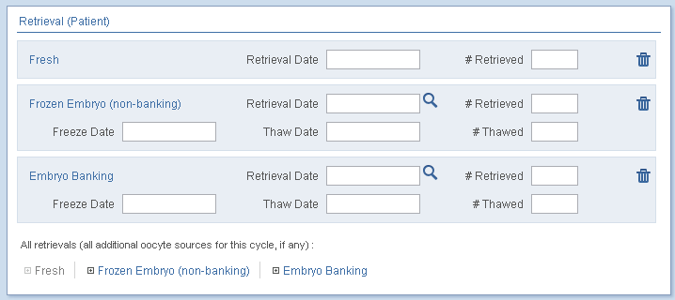
Multiple Retrieval Entry

Slide 30
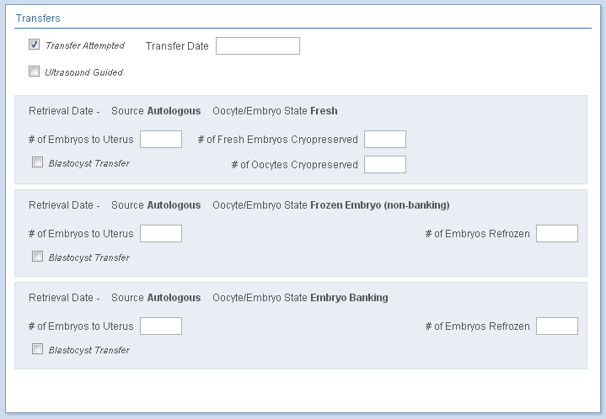
Multiple Transfer Entry

